Slide 1

B.TECH. MAJOR PROJECT
JAN 2020 – JUNE 2020
Submitted By: Akshay Gidwani (CSE , 16101006)
SUPERVISED BY: dr. Vivek tiwari
Forecasting COVID-19’s Positive Cases & Deaths on Global & India Data

Slide 2

FACTS ABOUT COVID-19
COVID-19, coined as SARS-Cov-2, is a Severe Acute Respiratory Syndrome, and is long prevailing in animals like camels, bats
First official human-case was reported on January 22, 2020 in Wuhan, China. Though few sources believe it had affected humans earlier during October-December 2019
For India, the first case was reported on January 30, 2020 in the Kerala state
General symptoms of the infection is dry cough, fever, tiredness, body-ache which worsens to difficulty in breathing, chest-pain, loss of speech and movement
It was found that the virus can spread through touch or in-take of respiratory particles from the infected person resulting in quick-exponential spread, ending up being a pandemic from epidemic

Slide 3
“PREVENTION IS BETTER THAN CURE”
Always advised:

Slide 4

Objective
“To study the trends of COVID-19 for India & World and Forecast the expected future trends”
solution
Use Machine Learning techniques and Statistical methods to forecast the Number of Cases and Deaths for India and Global Data
Impact
An aid to analysing & creating control measures and policies to governments and a study which might help in creating accurate hybrid pandemic model

Slide 5
Roadmap
Related Works
An overview view on previous works done on:
Results & Discussion
- Evaluation Parameter Used
- Analyzed and formulated outputs and insights from it
Methodology applied
Conclusion & Future Scope
Final output deduction and discussion on future aspects of improvement
- Traditional Epidemic models
- Forecast Case Study – COVID19
- Hybrid AI model
- Forecasting models used on Global and India Data separately
- Data-set
- EDA

Slide 6
Roadmap
Related Works
An overview view on previous works done on:
Results & Discussion
- Evaluation Parameter Used
- Analyzed and formulated outputs and insights from it
Methodology applied
Conclusion & Future Scope
Final output deduction and discussion on future aspects of improvement
- Traditional Epidemic models
- Forecast Case Study – COVID19
- Hybrid AI model
- Forecasting models used on Global and India Data separately
- Data-set
- EDA

Slide 7

Related work
Traditional Epidemic SEIR models uses differential equations of No. of Susceptible individuals(S), Estimated head-count of individuals in incubation(E), No. of Infected individuals(I), and No. of Recovered individuals(R) to capture the trends.
An SIR model successfully able to identify trends of Ebola in Gorilla [1]
Fruitful results for measuring the impact of awareness programs for HIV-AIDS using SIR model [2]
Modified SEIR model [3,4] for COVID-19 trend analysis; couldn’t forecast well since they weren’t able to capture factors like limited medical information, asymptotic transmission etc.

Slide 8
Related work
A case study on COVID-19 using supervised models like ETS, Linear Regression, LASSO, SVM with 60 days data since 22-01-2020 [5]
ETS performed the best with 406 MAE while SVM the poorest with 3129 MAE
A Hybrid AI model: ISI + NLP + LSTM inculcating measures to include asymptotic spread using tweets, and news articles [6]
An accurate model with 0.52%, 0.38%, 0.05%, and 0.86% for the next six days in Wuhan, Beijing, Shanghai, and countrywide, respectively

Slide 9
Roadmap
Related Works
An overview view on previous works done on:
Results & Discussion
- Evaluation Parameter Used
- Analyzed and formulated outputs and insights from it
Methodology applied
Conclusion & Future Scope
Final output deduction and discussion on future aspects of improvement
- Traditional Epidemic models
- Forecast Case Study – COVID19
- Hybrid AI model
- Forecasting models used on Global and India Data separately
- Data-set
- EDA

Slide 10
Dataset
Table 1: A snapshot of Global Data
Date | State | Country | Confirmed Cases | Fatalities
22/01/20 |  | Afghanistan | 0 | 0
22/01/20 | Washington | US | 0 | 0
22/01/20 |  | India | 0 | 0
22/01/20 | Victoria | Australia | 0 | 0
22/01/20 | Wuhan | China | 10 | 0
Global Data [7]:
313 unique regions,
Start date: 22/01/20 (for all regions)
End date: 19/04/20 (for all regions)
Region = (State, Country)
Total number of rows: 27,857
Table 2: A snapshot of India Data
Date | State or UT | Confirmed Cases | Fatalities | Recovery
30/01/20 | Kerala | 1 | 0 | 0
31/02/20 | Kerala | 1 | 0 | 0
01/02/20 | Kerala | 2 | 0 | 0
02/02/20 | Kerala | 2 | 0 | 0
03/02/20 | Kerala | 2 | 0 | 0
India Data [8]:
35 unique regions,
Start date: different for all regions
End date: 19/05/20 (for all regions)
Region = State or Union Territory
Total number of rows: 2000

Slide 11
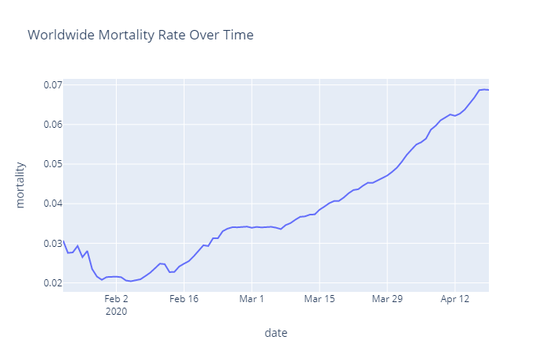
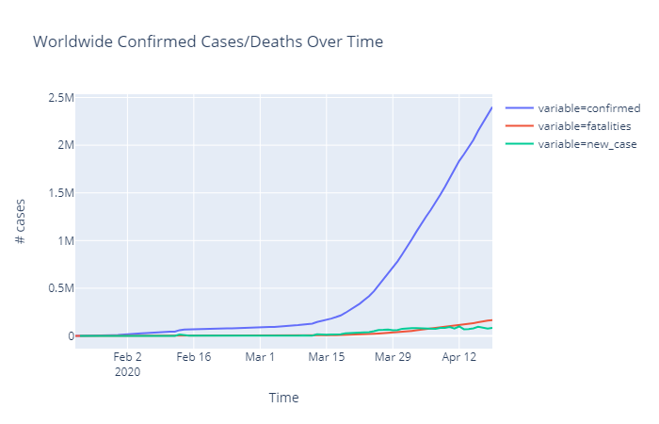
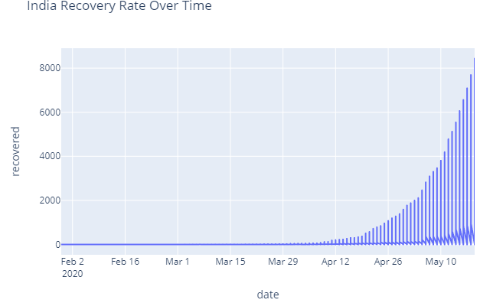
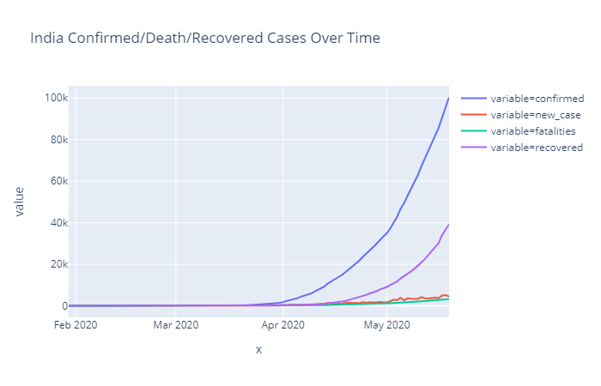
Exploratory Data Analysis
Worldwide Confirmed Cases, fatalities, and new cases
Worldwide Mortality Rate
Indian
Confirmed Cases, fatalities, and new cases
India Recovery Rate

Slide 12
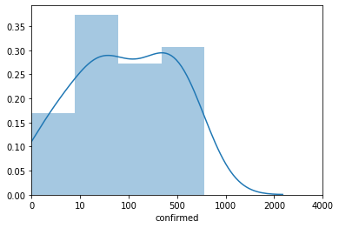
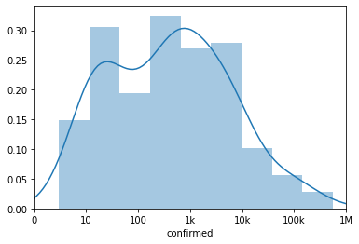
Exploratory Data Analysis
Global region percentage count confirmed cases wise histogram
Indian region percentage count confirmed cases wise histogram

Slide 13
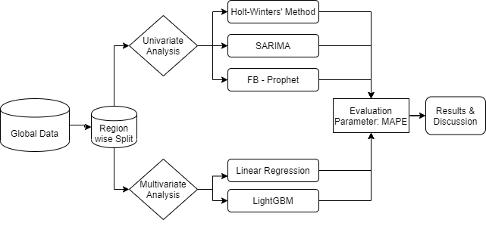
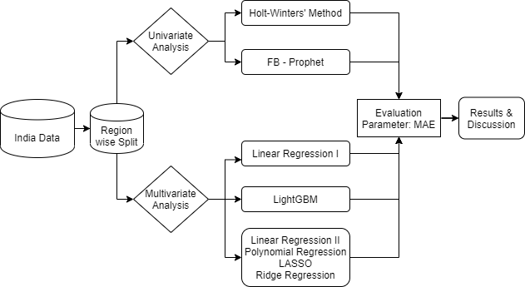
Modelling
Global data
CASE I
CASE II
India data
Cumulative data
Individual-day data
Modelling flow for both Confirmed Cases and Fatalities

Slide 14
Case I: Forecasting on Global data (Univariate methods)
Seasonal Autoregressive Integrated Moving Average method (SARIMA)
It is an extension of ARIMA that explicitly supports univariate time series data with a seasonal component
ARIMA uses lag features, differencing, and moving averages to compute the trend
Used ‘pmdarima’ library to choose the best values for the parameters and converting the series into stationary automatically
Facebook’s Prophet Model
It is based on an additive model where non-linear trends are fit with yearly, weekly, and daily seasonality, plus holiday effects. It is robust to missing data and shifts in the trend, and typically handles outliers well.
It uses change_points as on of it parameters which generally means special dates/times where the series has change or more impact
Used the change_point_scale=40, daily and weekly seasonality and linear growth as parameter values
Holt-Winters’ Seasonal Method or Triple Exponential Smoothing (HW-TES)
It is very simple method according to which recent history is more valuable than distant past. It, therefore, give weights to every value in the series, more to recent less to distant values
It uses three parameter equations for level, trend, and seasonality
Used maximum likelihood optimisation with a random parameter value at the beginning

Slide 15
Case I: Forecasting on Global data (Multivariate methods)
Linear Regression
Regressed on last one week’s delta-increase value, where delta-increase is the ratio of Confirmed cases at ith day to Confirmed cases at (i-1)^{th} day
Used One-step-ahead forecast, where test delta-increase values are a average of damper((i-5)^{th} day value), predicted value from model and average delta-increase value
Confirmed Cases value for i^{th} day=product of delta-increase for i^{th} day & Confirmed case value for (i-1)^{th} day
Fatalities value for i^{th} day=product of Confirmed cases value for ith day & last available mortality rate in train data
Light Gradient Boosting Method (LightGBM or LGBM)
LightGBM is a faster version of GBM in terms of tree growth & finding best split. It is an ensemble learning of decision trees with several regularisation applied to prevent overfitting
Since, it is a multi-variate non-parametric method, therefore, I created n=7 days log-lag features and log-moving average features similar to ARIMA
Confirmed Cases parameters: num_leaves=85, learning_rate=10^{-1.89}, n_estimators=100, min_sum_hessian_in_leaf=10^{-4.1}, min_child_samples=2, subsample =0.97, subsample_freq=10, colsample_bytree = 0.68, reg_lambda=10^{1.4}
Fatalities parameters: num_leaves=26, learning_rate=10^{-1.63}, n_estimators=100, min_sum_hessian_in_leaf=10^{-4.04} , min_child_samples=14, subsample =0.66, subsample_freq=5, colsample_bytree = 0.8,reg_lambda=10^{1.92}

Slide 16
Case II: Forecasting on INDIA data (Univariate methods)
Holt-Winters’ Seasonal Method or Triple Exponential Smoothing (HW-TES)
Same as that of Global Data’s Univariate Modelling
Facebook’s Prophet Model
It uses change_points as on of its parameters which generally means special dates/times where the series has change or more impact
Used the change_point_scale=50, daily and weekly seasonality and logistic growth as parameter values

Slide 17
Case II: Forecasting on INDIA data (Multivariate methods)
Linear Regression I & LightGBM
Same as that of Global Data’s Multivariate Modelling
Linear Regression II, Polynomial Regression, LASSO & Ridge Regression
Collected Indian state-union territory wise weather details like temperature, rainfall humidity, etc. average value, census details like population density, population count, slum household details, sex-ratio, literacy rate and state wise NSDP data for 2017, 2018, 2019
Created lag, trend value features along with features from the date values like day, week, month of the year, day since first case in that region
Used 4 Lockdown periods(March 24 - April 14, April 15 – May 3, May 4 - May 17, May 18 – May 31) as flag variables
Used above data directly for Linear Regression II
Created second degree features from above data and fed to data into Polynomial Regression
Used above for LASSO and Ridge Regression with nested time-series cross validation technique

Slide 18
Roadmap
Related Works
An overview view on previous works done on:
Results & Discussion
- Evaluation Parameter Used
- Analyzed and formulated outputs and insights from it
Methodology applied
Conclusion & Future Scope
Final output deduction and discussion on future aspects of improvement
- Traditional Epidemic models
- Forecast Case Study – COVID19
- Hybrid AI model
- Forecasting models used on Global and India Data separately
- Data-set
- EDA

Slide 19
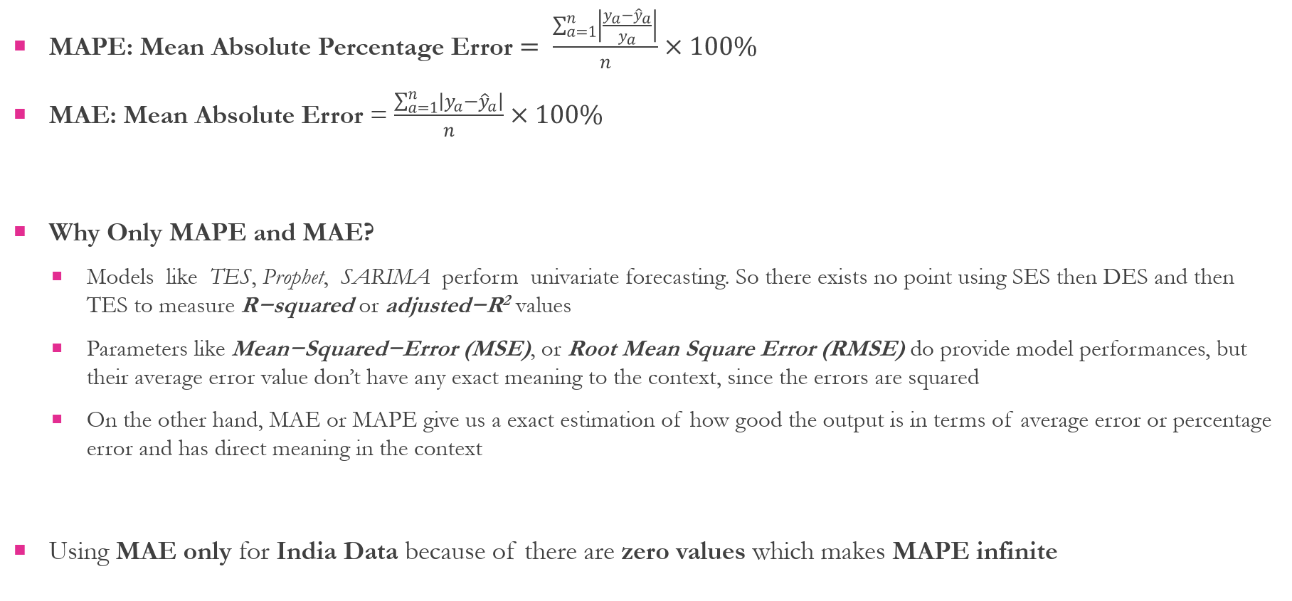
Evaluation Parameters used
MAPE: Mean Absolute Percentage Error $= \frac{\sum_{a=1}^{n}{\left|\frac{y_{a}−{\hat{y}}_{a}}{y_{a}}\right|}}{n}×100\%$
MAE: Mean Absolute Error = $\frac{\sum_{a=1}^{n}{\left|y_{a}−{\hat{y}}_{a}\right|}}{n}×100\%$
Why Only MAPE and MAE?
Models like TES, Prophet, SARIMA perform univariate forecasting. So there exists no point using SES then DES and then TES to measure R−squared or adjusted−R² values
Parameters like Mean−Squared−Error (MSE), or Root Mean Square Error (RMSE) do provide model performances, but their average error value don’t have any exact meaning to the context, since the errors are squared
On the other hand, MAE or MAPE give us a exact estimation of how good the output is in terms of average error or percentage error and has direct meaning in the context
Using MAE only for India Data because of there are zero values which makes MAPE infinite

Slide 20
RESULTS (Average Performance Evaluation)
Inferences
HW-TES & SARIMA model performs the best on Global Data for both Confirmed Cases and Fatalities
MAPE % for Fatalities is more for all models because of the lesser actual value as compared to large confirmed cases values

Slide 21
RESULTS (Average Performance Evaluation)
Inferences
HW-TES & Prophet model performs the best on India Data for both Confirmed Cases and Fatalities
LRI, LRII and PR perform worst with out of the charts MAE values for both confirmed cases and

Slide 22
results (UNIVARIATE VS multivariate)
Inferences
Univariate methods performs the better than Multivariate methods for both Confirmed Cases and Fatalities because of easy parameter optimisation

Slide 23
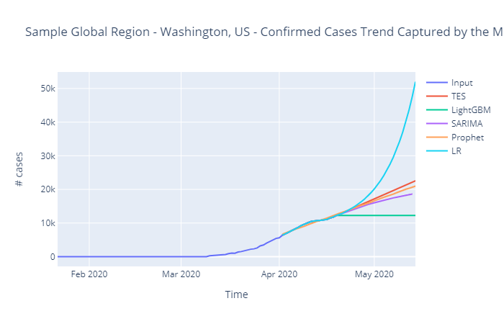
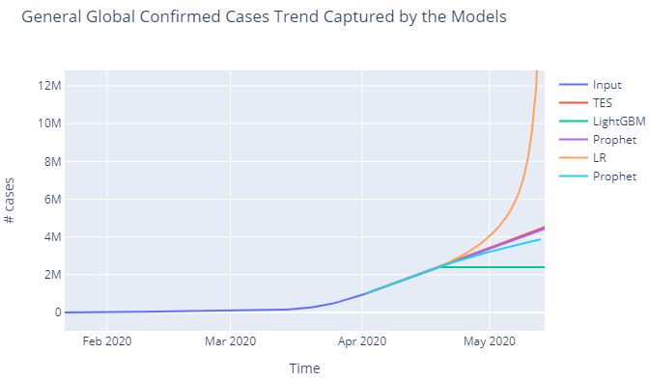
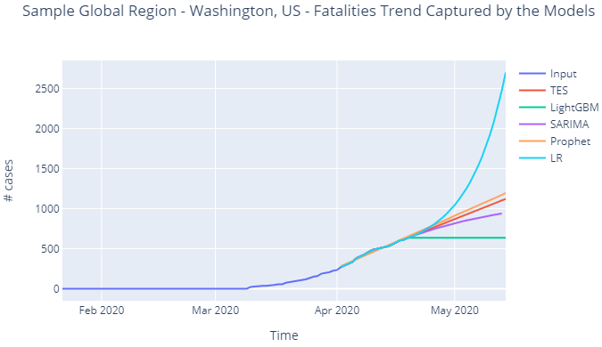
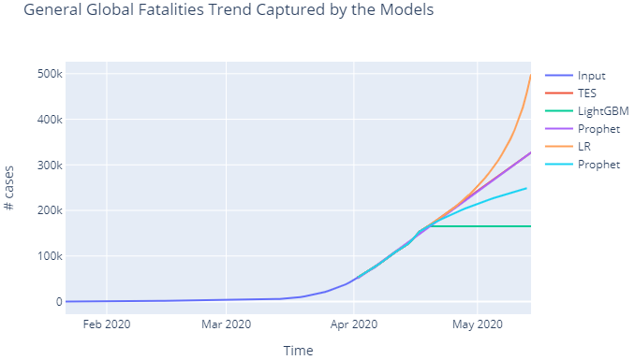
RESULTS (Global Trends captured)
Sample Region – Washington, US
Summed-up Global
Inferences
Global & Sample region have similar trend for all models
HW-TES performs the best while LR has the worst performance
SARIMA and HW-TES have similar trends
Confirmed Cases
Fatalities

Slide 24
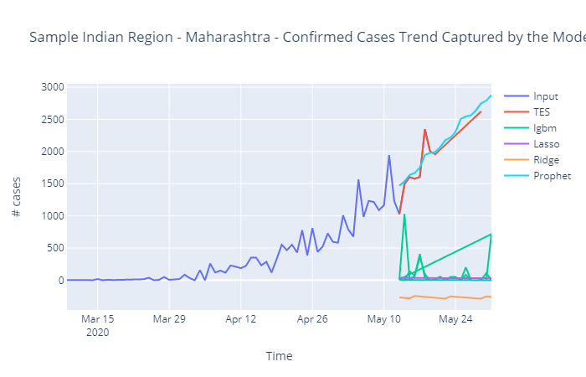
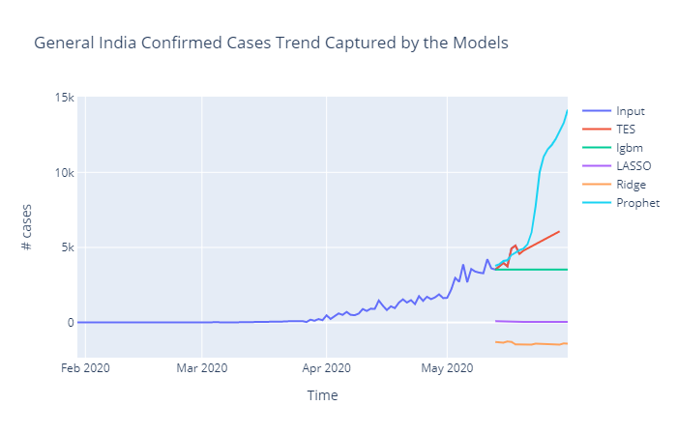
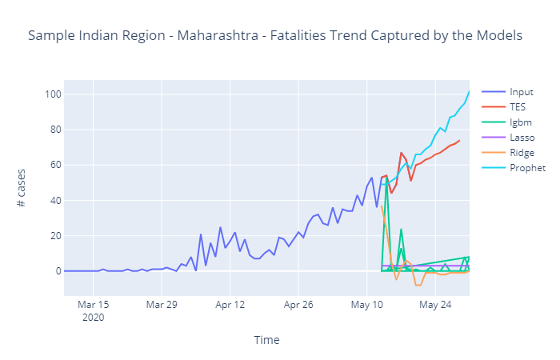
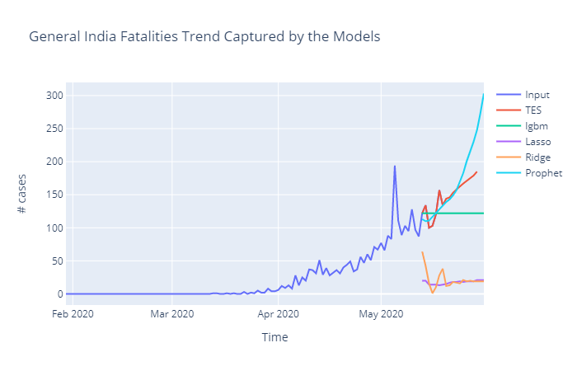
RESULTS (India Trends captured)
Sample Region – Maharashtra
Summed-up India
Inferences
Indian & Sample region have similar trend for TES, Ridge, LASSO while Prophet’s trend overwhelmingly increases & LightGBM just flattens out for Indian trend
Regression models (LGBM, LASSO, Ridge) aren’t able to capture the trend while TES and Prophet do it very well
Confirmed Cases
Fatalities

Slide 25
Tableau dashboard
India Data Results: https://public.tableau.com/profile/akshay.gidwani#!/vizhome/India_results/Dashboard2
Global Data Results: https://public.tableau.com/profile/akshay.gidwani#!/vizhome/global_results/Dashboard1

Slide 26
case study: WHY REGION-Split during modelling
Inferences
The splitted Indian-region from India Data perform way better already summed up Indian Region in Global Data for both Confirmed Cases and Fatalities
OR
Confirmed Cases
Fatalities

Slide 27
Roadmap
Related Works
An overview view on previous works done on:
Results & Discussion
- Evaluation Parameter Used
- Analyzed and formulated outputs and insights from it
Methodology applied
Conclusion & Future Scope
Final output deduction and discussion on future aspects of improvement
- Traditional Epidemic models
- Forecast Case Study – COVID19
- Hybrid AI model
- Forecasting models used on Global and India Data separately
- Data-set
- EDA

Slide 28
Conclusion
Holt-Winters’ Seasonal Method performs the best for forecasting of COVID-19
Multi-variate Regression models failed because of the improper independent feature inclusion and not using time-series cross validation
It is necessary to lower the level of COVID-19 pandemic data as much as possible for accurate forecasting

Slide 29
FUTURE Scope
A mixture of ML models along with HW-TES like NLP modules to incorporate awareness and different infection rates because of easy spread of COVID-19
Use other epidemic data, survey and analyze if they can be used too
Build models for real-time forecasting

Slide 30

THANK YOU

Slide 31
references
C. E. Rizkalla, F. J. Blanco-Silva, and S. Gruver, “Modeling the impact of ebola and bushmeat hunting onwestern lowland gorillas,” EcoHealth, vol. 4, pp. 151–155, 2007
O. Zakary, M. Rachik, and I. Elmouki, “Article: On the impact of awareness programs in HIV/AIDS prevention: An sir model with optimal control,” International Journal of Computer Applications, vol. 133, no. 9, pp.1–6, January 2016, published by Foundation of Computer Science (FCS), NY, USA.
Z. Yang, Z. Zeng, K. Wang, S.-S. Wong, W. Liang, M. Zanin, P. Liu, X. Cao, Z. Gao, Z. Mai, J. Liang,X. Liu, S. Li, Y. Li, F. Ye, W. Guan, Y. Yang, F. Li, S. Luo, Y. Xie, B. Liu, Z. Wang, S. Zhang,Y. Wang, N. Zhong, and J. He, “Modified seir and ai prediction of the epidemics trend of covid-19 in china under public health interventions,” Journal of Thoracic Disease, vol. 12, no. 3, 2020
Radulescu, Anca & Cavanagh, Kieran. (2020). Management strategies in a SEIR model of COVID-19 community spread. 10.13140/RG.2.2.12643.50726.
F. Rustam et al., "COVID-19 Future Forecasting Using Supervised Machine Learning Models," in IEEE Access, vol. 8, pp. 101489-101499, 2020, doi: 10.1109/ACCESS.2020.2997311.
N. Zheng et al., "Predicting COVID-19 in China Using Hybrid AI Model," in IEEE Transactions on Cybernetics, vol. 50, no. 7, pp. 2891-2904, July 2020, doi: 10.1109/TCYB.2020.2990162.

Slide 32
references
https://www.kaggle.com/c/covid19-global-forecasting-week-4/data
https://www.kaggle.com/sudalairajkumar/covid19-in-india/data

Slide 33

Contact
LinkedIn linkedin.com/in/akshay-gidwani
Twitter @g_akki98
Email gak2698@gmail.com
Phone +91-8827900681

